Slide 1
FIT TRACKER
Tatu Bogdan

Slide 2
Project Requirements
1

Slide 3
Project Requirements
An all-in-one gym app that tracks your workout progress, combined with a food tracker and calorie counter.
Create and customize a profile
Create a workout and add exercises to it (sets, reps, weight)
Search vast amounts of foods
Add/edit/remove foods from daily meals
View progress history
Notes:
An all-in-one gym app that tracks your workout progress, sets, reps, and weight, combined with a food tracker and calorie counter.
There are two types of users in the app: • User / Gym Member : A user who uses the app to track their workout progress and food intake. • Moderator : An administrator that handles the app, users and user created content. 1.1 App A user will be able to: • create a profile • search for other users and view their profiles • change their profile details (photo, name, email, password, etc.) • change their settings and preferences (notifications, theme, advertising, etc.) • delete their account A moderator will be able to: • delete other users’ accounts (bot accounts, spam accounts, etc.) 1.2 Workout Tracker A user will be able to: • create a workout (name, description, exercises, etc.) • add exercises to a workout (name, description, sets, reps, weight, etc.) • track their workout progress • view their workout history 1.3 Calorie Counter A user will be able to: • create a food/recipe (name, description, calories, etc.) • scan a food’s barcode to add it to their food list • add/edit/delete foods from their daily food intake • track their food intake history A moderator will be able to: • add/edit/delete foods from the app’s food list • award recipes with ”editor’s choice” status

Slide 4
Project Specifications
2

Slide 5
Project Specifications
01
Code Management
04
Frontend
02
Database
05
Hosting
03
API
Git and GitHub
Each platform on different repo
Web: Next.js
SSR, SEO
Mobile: React Native
Android and iOS
Tailwind CSS
MySQL on PlanetScale
Scalability and analytics
Web: Vercel
Mobile: Google Play Store and App Store
TypeScript with tRPC
Developer experience and reduced boilerplate
Notes:
Since the application will be multi-platform, git and GitHub will be used to manage the code, with a separate repository for each platform (native and Web) and another one for the back-end.
The database will be a relational database, using MySQL. The database will be hosted using PlanetScale, a cloud-native database platform, which will provide overall better performance, scalability, and security.
PlanetScale will also provide data analytics, which will help us to understand how users are using the application, and how we can improve it.
The application will use the same technology for the back-end and front-end, for a better developer experience. The back-end will be written in typescript and will use tRPC to build a modern type-safe API.
To have a better developer experience, tRCP also helps by defining the API's types and schema in a single file, making it easier to keep your code in sync with your API, and providing automatic type generation both the client and the server, to reduce the amount of boilerplate code and errors between manual type definitions.
Since the application is split into two platforms, the front-end will use different technologies for each platform. The native platform will use React Native since it can be used for both Android and iOS, while the Web platform will use Next.js, a React framework, to get the benefit of server-side rendering for faster page load time and improved search engine optimisation.
Both platforms will be styled using Tailwind CSS, a utility-first CSS framework, which will help us to build a consistent design system across the application and platforms.
The native platform will be hosted on the App Store and Google Play Store, while the Web platform will be hosted on Vercel, since it is a clear choice for Next.js, to automate the deployment process and use features like serverless functions, image optimization, edge caching, and more. It also provides analytics tools.

Slide 6
3
Task Breakdown

Slide 7
Task Breakdown
TASK | DURATION
Planning | 1 week
UI Design | 5 weeks (Web) & 5 weeks (Native)
UX Design and Integrations | 3 weeks
Backend Development | 4 weeks
Merging Functionality | 1 week
Testing | 3 days
Deployment | 1 day

Slide 8
Gantt Chart
4

Slide 9
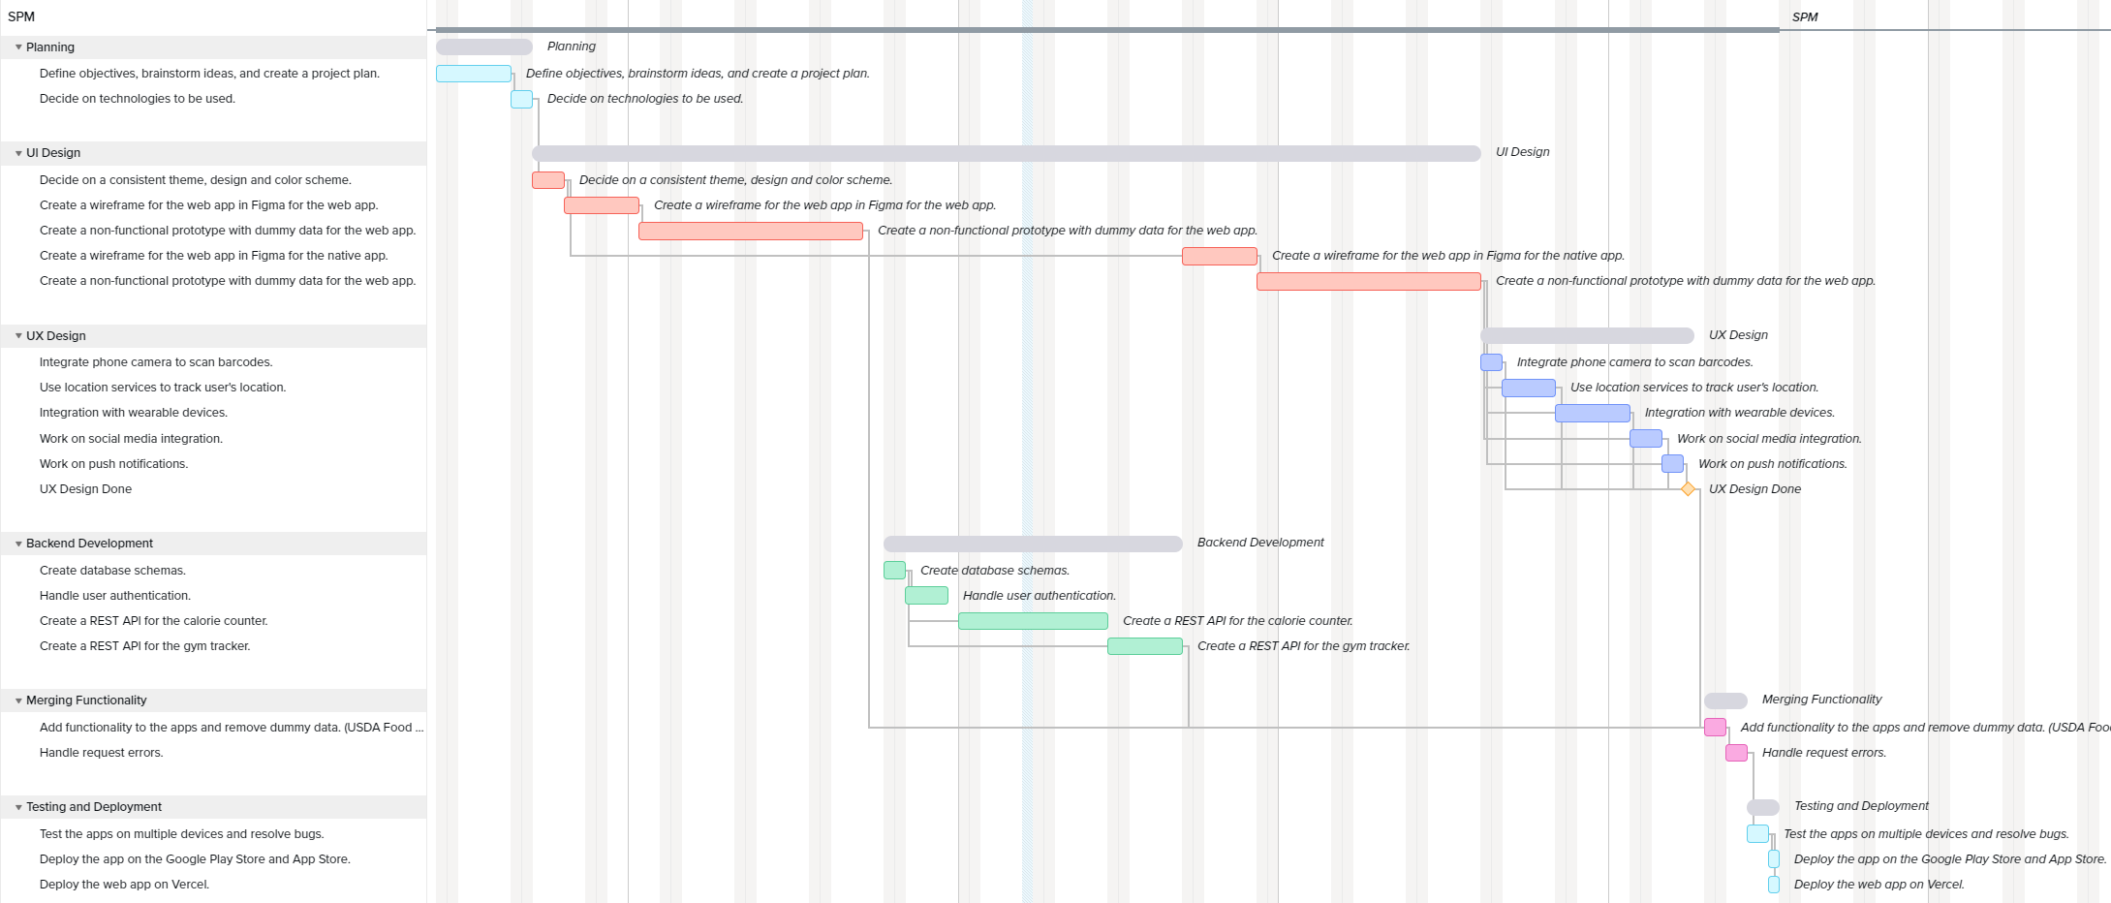
Gannt Chart
Notes:
Here are the tasks visualized in a gannt chart, with their respective durations and periods

Slide 10
SWOT Analysis
5

Slide 11
SWOT Analysis
S
W
O
T
Integration with wearable tech
Detailed analytics
Significant development resources
Competition
Limited early adoption
Growing fitness industry and nutrition knowledge
Subscription models
Gamification features
Disruption with AI and virtual reality
Changing market
Notes:
The app can offer a unique value proposition by combining gym tracking and calorie counting features in one app, which can make it stand out from competitors.
Integration with wearable technology can make the app more convenient and user-friendly, by automatically adding exercises and the caloric expenditure.
The app provides users with detailed analytics and progress tracking, allowing them to monitor their progress and adjust their fitness plans accordingly.
The app may require significant development resources to implement all of the desired features and functionality, which could increase costs and time to market.
User adoption may be limited by the need for consistent and accurate data entry, which can be time-consuming and tedious for some users.
The global fitness industry is growing, which presents an opportunity for the app to capture a share of this expanding market.
The app can offer a freemium model, with basic features available for free and advanced features available for a fee, which can attract a wider audience and generate revenue.
The app can be marketed through social media and partner with fitness brands and influencers to promote the app.
The app can offer gamification features, such as rewards and achievements, which can enhance user motivation and engagement.
There may be a significant level of market saturation and competition in the fitness app market, which could limit the app's ability to gain traction and attract users.
Emerging technologies such as artificial intelligence and virtual reality could disrupt the fitness industry and change user preferences for fitness apps.

Slide 12
Assessing Object-Oriented Design Quality

Slide 13
TECHNIQUES
Code reviews
Identify potential design issues.
Static code analysis
Analyze source code without executing it, identify code smells, duplicate code and security vulnerabilities.
Automated testing
Assuring that the design is testable, and it works.
Refactoring
Improving the design of existing code without changing its behavior.

Slide 14
PRINCIPLES
S
Single Responsibility Principle
Classes should be responsible for a single task. Keeps classes small,
focused and easier to maintain.
O
Open-Closed Principle
Classes, methods and software entities should be accept new functionality
without requiring modification of the existing code.
L
Liskov Substitution
Objects of a superclass should be able to be replaced with objects of a subclass
without breaking the system.
I
Interface Segregation Principle
Interfaces should be small and only contain the methods that a client requires,
avoid monolithic interfaces that are difficult to understand.
D
Dependency Inversion Principle
High-level modules should not depend on low-level modules. Both should depend
on abstractions, interfaces or abstract classes.

Slide 15
COMPOSITION vs INHERITANCE
Classes should achieve polymorphic behavior and code reuse by their composition, rather than inheritance from a base or parent class.
Inheritance
Sub-classes become dependent on parent classes.
Changes could create ripple effects.
Composition
Composing smaller, more focused classes out of functionalities.
Leads to more reusable and extendable code.
* May not always be the best approach. Developers should make the decision

